Slide 1
CSC127 – C++ Overview

Slide 2




Structure of C++ Program
Include Files
Class Definition Class Function Definition
Main Function Program

Slide 3
Simple C++ Program
// Hello World program
comment
#include <iostream.h>
Allows access to an I/O library
int main() {
Starts definition of special function main()
cout << "Hello World\n";
output (print) a
string
return 0;
}
Program returns a status code (0 means OK)

Slide 4







Preprocessing
Temporary file (C++ program)
C++
Preprocessor
C++
Compiler
C++ Program
Executable Program

Slide 5
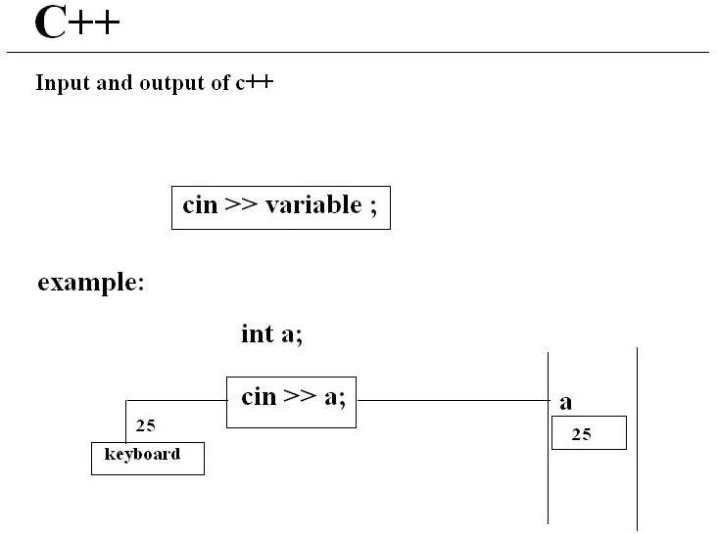

Slide 6
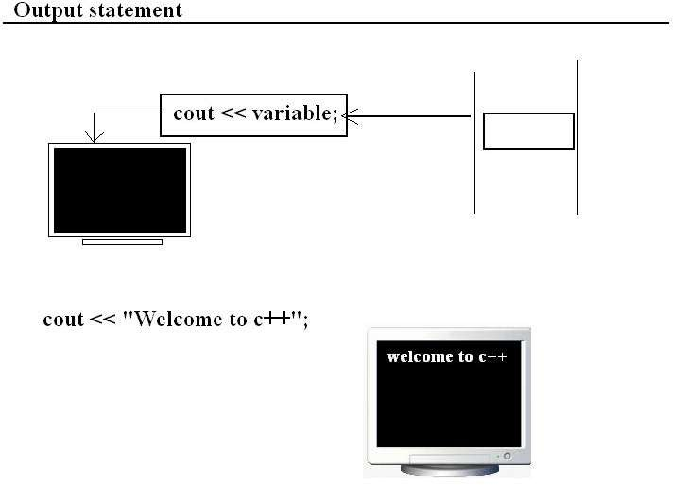

Slide 7
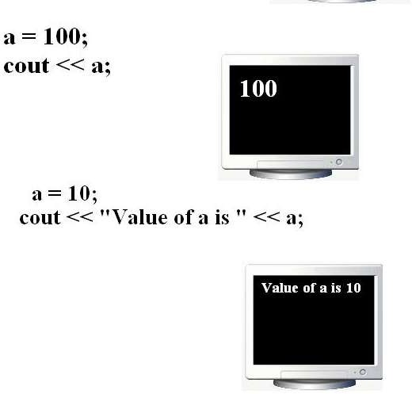

Slide 8
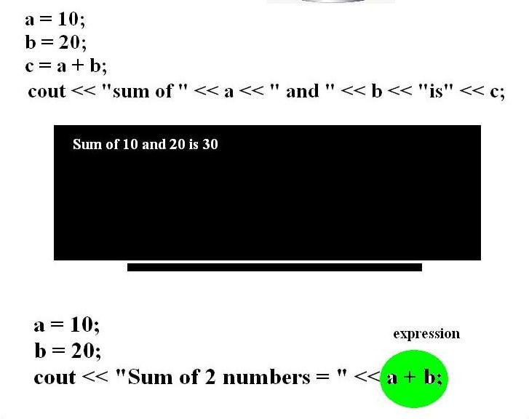

Slide 9
C++ LANGUAGE
C++ Program is a collection of
Tokens
Comments
White Space

Slide 10





C++ TOKENS
RESERVED KEYWORDS
IDENTIFIERS LITERALS OPERATORS SEPARATORS

Slide 11

RESERVED KEYWORDS
Has predefined functionality
C++ has 48 keywords
Written in only in lower case

Slide 12
RESERVED KEYWORDS
delete | boolean | Break | Enum
case | volatile | catch | char
const | continue | default | do
else | asm | extern | union
float | for | Auto | unsigned
if | inline | register | class
int | template | long | double
virtual | operator | Signed | goto
protected | public | sizeof | return
Static | Struct | this | new
friend | throw | typedef | private
try | switch | while | short

Slide 13

IDENTIFIERS
Programmer-designed tokens
Meaningful & short
Long enough to understand
C++ rules for Identifiers
alphabets, digits, underscore
should not start with digits.
Case sensitive
Unlimited length
Declared anywhere

Slide 14

LITERALS
Sequence of char. that represents constant values to be stored in variables
C++ literals are:
Integer literals: 1,2,456,0xffff
Floating_point literals: 4.67,3.14E-05
Charater literals: ‘A’, ‘B’
String literals: “ABC”, “TOTAL”

Slide 15
LITERALS (Symbolic Constants)
Using const qualifier ex: const int size=10;
Using enum keyword ex: enum{X,Y,Z};
defines const X=0; defines const Y=0; defines const Z=0;

Slide 16

OPERATORS
Is a symbol that takes more than one operands & operates on them to produce a result.
Arithmetic
Relational
Logical
Assignment
increment/Decrement
conditional
scope resolution(::)
special operators: new, delete, endl, setw

Slide 17
SEPARATORS
Symbols used to indicate where groups of code are divided & arranged
C++ separators:
()parentheses .. Methods, precedence in exp
{} braces .. Arrays init., block of codes, scopes
; semicolon
,comma.. Separate multiple identifiers, chain more than one stmt
. Period.. Data members, methods
[]Brackets.. Array referencing/dereferencing

Slide 18



























C++ STATEMENTS
C++ stmts
Exp
stmt
Labelled
stmt
Guarding
stmt
Control stmt
Selection stmt
Iteration stmt
Jump stmt
If
If else
do
for
contin ue
switch
while
break
return

Slide 19
Arrays in C++
An array is a consecutive group of memory locations.
An array is a collection of similar data elements.

Slide 20

Memory and Arrays
Each int is 2 bytes
16 bits
a[0]
a[1]
int a[6];
a[5]

Slide 21
Array Initialization
We can initialize an array :
int a[5] = { 1,8,3,6,12};
double d[2] = { 0.707, 0.707}; char s[] = { 'R', 'P', 'I' };
NOTE:
Need not have to specify a size when initializing, the compiler will count automatically.

Slide 22
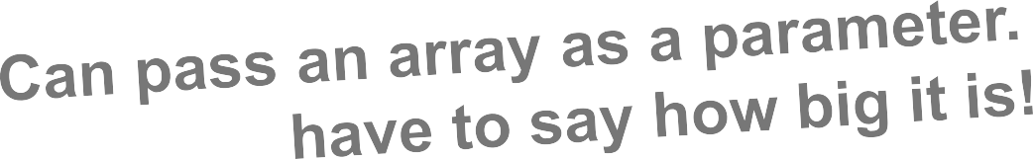
An array printing function
void print_array(int a[], int len)
{
for (int i=0;i<len;i++)
cout << "[" << i << "] = "
<< a[i] << endl;
}

Slide 23
Arrays of char are special
C++ provides a special way to deal with arrays of characters:
char str[] = “C++ char Arrays";
char arrays can be initialized with string literals.

Slide 24
2-D Array: int A[3][4]
Col 0
Col 1
Col 2
Col 3
Row 0
Row 1
Row 2
A[0][0] | A[0][1] | A[0][2] | A[0][3]
A[1][0] | A[1][1] | A[1][2] | A[1][3]
A[2][0] | A[2][1] | A[2][2] | A[2][3]

Slide 25
2-D Memory Organization
{
A[0][0]
A[0][1]
A[0][2]
A[1][0]
A[1][1]
A[1][2]
A[2][0]
A[2][1]
A[2][2]
A[3][0]
A[3][1]
A[3][2]
char A[4][3];
A[0]
{
A is an array of size 4.
A[1]
{
Each element of A is an array of 3 chars
A[2]
A[3]
{

Slide 26
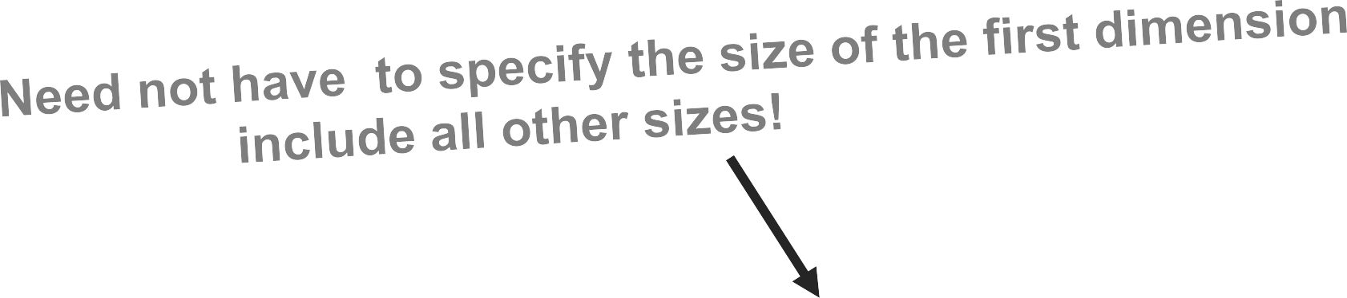
2-D Array
double student_average( double g[][NumHW], int stu)
{
double sum = 0.0;
for (int i=0;i<NumHW;i++) sum += g[stu][i];
return(sum/NumHW);
}

Slide 27
C++ Strings
Supports C-String
C++ defines a string class called string
The string class supports several constructors. The prototypes of commonly used one is
– string( );
ex: string str("Alpha");

Slide 28
C++ Strings
Operator
=
+
+=
==
!=
<
<=
Meaning Assignment Concatenation
Concatenation assignment Equality
Inequality Less than
Less than or equal
Greater than
Greater than or equal
Reads Prints
>
>=
>>
<<

Slide 29
C++ Strings
str2 = str1; // assigning a string
str3 = str1 + str2; //concatenating strings
if(str2 > str1) cout<<” str2 is bin“;//compares
str1 = "This is a null-terminated string.\n";
cin>>str1; //reads
Cout<<str1; //prints

